Slide 1
Operating System

Slide 2
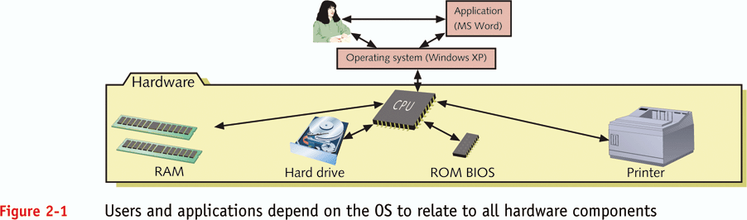
What is an operating system (OS)?

Slide 3
Need of Operating System:
In earlier day’s user had to design the application according to the internal structure of the hardware. Operating System was needed to enable the user to design the application without concerning the details of the computer’s internal structure. In general the boundary between the hardware & software is transparent to the user.
The purpose of an operating system is to –provide an environment in which a user can execute programs.
Usage of Operating System:
Easy interaction between the human & computer.
Starting computer operation automatically when power in turned on.
Loading & scheduling users program.
Controlling input & output.
Controlling program execution.
Managing use of main memory.
Providing security to users program.

Slide 4
Definition of Operating System: -
An Operating System is an essential component of a computer system. It is a large set of large and complex program that acts as an interface between the computer hardware & its user. Its serves twin objectives, interpreting the user program instructions to the hardware as well as providing coordination services necessary to enable a group of users to share computer system resources efficiently.
Goals
–make the computer system convenient to use
–Allow users to use the computer hardware in an efficient manner

Slide 5

Logical Architecture of a Computer System
OS is designed to serve two basic purposes:
It controls the allocation and use of the computing System’s resources among the various user and tasks.
It provides an interface between the computer hardware and the programmer that simplifies and makes feasible for coding, creation, debugging of application programs.
Users
Other System Software and Application Programs
Operating System
Computer Hardware
Slide 5/54

Slide 6
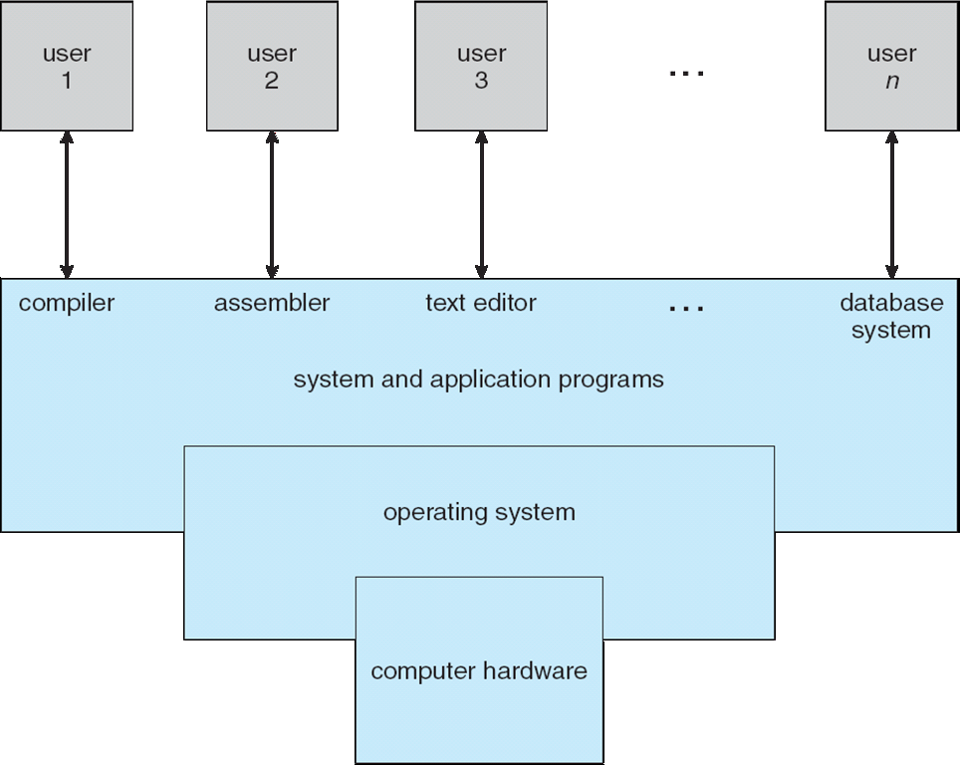
Static View of System Components
Every computer must have an operating system to run other programs. The operating system coordinates the use of the hardware among the various system programs and application programs for various users. It simply provides an environment within which other programs can do useful work.
The operating system is a set of special programs that run on a computer system that allows it to work properly. It performs basic tasks such as recognizing input from the keyboard, keeping track of files and directories on the disk, sending output to the display screen and controlling peripheral devices.

Slide 7
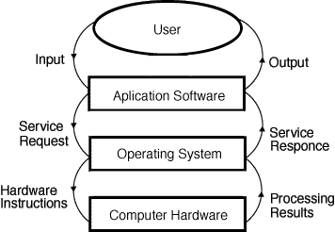
Dynamic View of System Components

Slide 8
Layers of a Computer System
End
User
Programmer
Application
Programs
Utilities
Operating-
System
Designer
Operating-System
Computer Hardware

Slide 9
OSes provide environments in which programs run, and services for the users of the system, including:
User Interfaces - Means by which users can issue commands to the system. Depending on the system these may be a command-line interface ( e.g. sh, csh, ksh, tcsh, etc. ), a GUI interface ( e.g. Windows, X-Windows, KDE, Gnome, etc. ), or a batch command systems. The latter are generally older systems using punch cards of job-control language, JCL, but may still be used today for specialty systems designed for a single purpose.
Program Execution - The OS must be able to load a program into RAM, run the program, and terminate the program, either normally or abnormally.
I/O Operations - The OS is responsible for transferring data to and from I/O devices, including keyboards, terminals, printers, and storage devices.
File-System Manipulation - In addition to raw data storage, the OS is also responsible for maintaining directory and subdirectory structures, mapping file names to specific blocks of data storage, and providing tools for navigating and utilizing the file system.
Communications - Inter-process communications, IPC, either between processes running on the same processor, or between processes running on separate processors or separate machines. May be implemented as either shared memory or message passing, ( or some systems may offer both. )
Error Detection - Both hardware and software errors must be detected and handled appropriately, with a minimum of harmful repercussions. Some systems may include complex error avoidance or recovery systems, including backups, RAID drives, and other redundant systems. Debugging and diagnostic tools aid users and administrators in tracing down the cause of problems

Slide 10
Operation of an OS
To facilitate scheduling, resource management, and security and protection
OS maintains various kinds of information to facilitate operation
Names of registered users
identification of a user who is executing a specific program
status of a program
status of a resource
which users can access a resource
OS performs several tasks repeatedly to implement scheduling, resource management, security and protection

Slide 11
Views of an Operating System
There are three classical views (in literature):
Resource Manager – manages and allocates resources.
Control program – controls the execution of user programs and operations of I/O devices.
Command Executer – Provides an environment for running user commands.

Slide 12
1. Resource Manager
Manages and protects multiple computer resources: CPU, Processes, Internal/External memory, Tasks, Applications, Users, Communication channels, etc…
Handles and allocates resources to multiple users or multiple programs running at the same time and space (e.g., processor time, memory, I/O devices).
Decides between conflicting requests for efficient and fair resource use (e.g., maximize throughput, minimize response time).

Slide 13
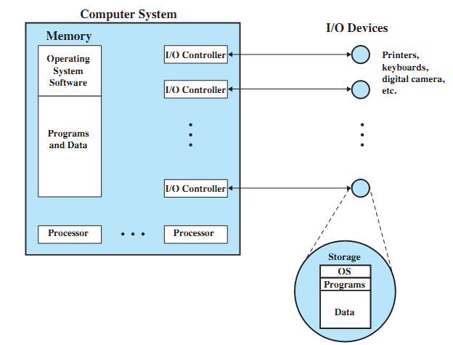
OS as a Resource Manager

Slide 14

2. Control Program
Manages all the components of a complex computer system in an integrated manner.
Controls the execution of user programs and I/O devices to prevent errors and improper use of computer resources.

Slide 15
3. Command Executer
Interfaces between the users and machine.
Supplies services/utilities to users.
Provides the users with a convenient CLI (Command Language Interface), also called a Shell (in UNIX), for entering the user commands.

